Slide 1
Algorithms Analysis

Slide 2
Comparison of Algorithms
What is the goal?
To compare different algorithms!
How is running time increases as the size of the problem increases?
time = f(size)
Other factors can be considered (e.g., memory requirements, programmer's effort etc.)

Slide 3
Running Time Analysis
  Provides upper and lower bounds of running time.
Types of analysis
  - Worst case
  - Best case
  - Average case

Slide 4
Worst Case
Provides an upper bound on running time.
An absolute guarantee that the algorithm would not run longer, no matter what the inputs are.

Slide 5
Best Case
Provides a lower bound on running time.
Input is the one for which the algorithm runs the fastest.

Slide 6
Average Case
Provides a prediction on “average” running time.
Assumes that the input is random.
Useful when Best/Worst times correspond to very few input cases only.

Slide 7
Example: Searching
Problem of searching an ordered list.
  Given a list L of n elements that are sorted into a definite order (e.g., numeric, alphabetical),
  And given a particular element x,
  Determine whether x appears in the list, and if so, return its index (position) in the list.

Slide 8
Linear Search
procedure linear search
(x: integer, a₁, a₂, …, a_{n}: distinct integers)
i := 1
while (i ≤ n ∧ x ≠ a_{i})
i := i + 1
if i ≤ n then location := i
else location := 0
return location {index or 0 if not found}

Slide 9
What is the size of a problem?
Typically, it is straightforward to identify the size of a problem, e.g.:
  size of array
  size of stack, queue, list etc.
  vertices and edges in a graph
But not always …

Slide 10
How do we analyze an algorithm?
We need to define a number of objective measures.
(1) Compare execution times?
Not good: times are specific to a particular machine !!
(2) Count the number of statements?
Not good: number of statements vary with the programming language as well as the style of the individual programmer.

Slide 11
Example
Algorithm 1 Algorithm 2
arr[0] = 0; for(i=0; i<N; i++)
arr[1] = 0; arr[i] = 0;
arr[2] = 0;
...
arr[N-1] = 0;

Slide 12
How do we analyze an algorithm? (cont.)
(3) Express running time t as a function of problem size n (i.e., t=f(n) ).
    To compare two algorithms with running times f(n) and g(n), we need to find which functions grows faster (i.e., compare their rate of growth!)
    - Such an analysis is independent of machine time, programming style, etc.

Slide 13
Running time = f (problem size)
(1) Associate a "cost" with each statement.
(2) Find the total number of times each statement is executed.
(3) Add up the costs.
Algorithm 1 Algorithm 2
Cost Cost
arr[0] = 0; c1 for(i=0; i<N; i++) c2
arr[1] = 0; c1 arr[i] = 0; c1
arr[2] = 0; c1
...
arr[N-1] = 0; c1
----------- -------------
c1+c1+...+c1 = c1 x N (N+1) x c2 + N x c1 =
(c2 + c1) x N + c2

Slide 14
Running time = f (problem size) (cont.)
Cost
sum = 0; c1
for(i=0; i<N; i++) c2
for(j=0; j<N; j++) c2
sum += arr[i][j]; c3
------------
c1 + c2 x (N+1) + c2 x N x (N+1) + c3 x N x N

Slide 15
Understanding Rate of Growth
Consider the example of buying elephants and goldfish:
Cost: (cost_of_elephants) + (cost_of_goldfish)
or Cost ~ cost_of_elephants (approximation)
The low order terms of a function are relatively insignificant for large n
n⁴ + 100n² + 10n + 50 ~ n⁴
The highest order term of a function determines its rate of growth!

Slide 16
Example
Suppose you are designing a website to process user data (e.g., financial records).
Suppose program A takes f_{A}(n)=30n+8 microseconds to process any n records, while program B takes f_{B}(n)=n²+1 microseconds to process the n records.
Which program would you choose, knowing you’ll want to support millions of users?
A
Compare rates of growth
30n+8 ~ n n²+1 ~ n²

Slide 17
Rate of Growth ≡Asymptotic Analysis
Using rate of growth as a measure to compare different functions implies comparing them asymptotically (i.e., as n → ∞)
If f(x) is faster growing than g(x), then f(x) always eventually becomes larger than g(x) in the limit (i.e., for large enough values of x).

Slide 18
Visualizing Orders of Growth
On a graph, as
you go to the
right, a faster
growing
function
eventually
becomes
larger...
f_{A}(n)=30n+8
Value of function →
f_{B}(n)=n²+1
Increasing n →

Slide 19
Asymptotic Notation
O notation: asymptotic “less than”:
  f(n)=O(g(n)) implies: f(n) “≤” g(n)
(used in Worst-Case analysis)

Slide 20
Asymptotic Notation
Ω notation: asymptotic “greater than”:
  f(n)= Ω (g(n)) implies: f(n) “≥” g(n)
(used in Best-Case analysis)

Slide 21
Asymptotic Notation
Θ notation: asymptotic “equality”:
  f(n)= Θ (g(n)) implies: f(n) “=” g(n)
(provides a tight bound of running time)

Slide 22
Big-O Notation
Given two functions f(n) and g(n), we say that f(n) is O(g(n)) if :
f(n)≤cg(n)” for large n values, c is const
Example: f_{A}(n)=30n+8 is order n, or O(n).
It is, at most, roughly proportional to n.
Example: f_{B}(n)=n²+1 is order n², or O(n²).
It is, at most, roughly proportional to n².

Slide 23
Algorithm / Function
In general, an O(n²) algorithm will be slower than O(n) algorithm (maybe not for small values of n).
Warning: an O(n²) function will grow faster than an O(n) function.
f_{A}(n)=30n+8
Value of function →
f_{B}(n)=n²+1
Increasing n →

Slide 24
More Examples …
We say that n⁴ + 100n² + 10n + 50 is of the order of O(n⁴)
We say that 10n³ + 2n² is O(n³)
We say that n³ - n² is O(n³)
We say that 10 is O(1),
We say that 1273 is O(1)

Slide 25
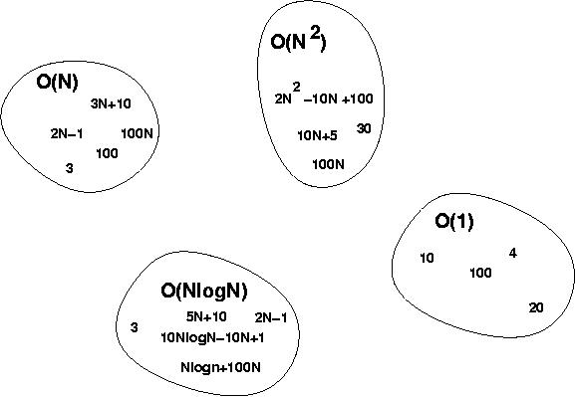
More on big-O
f(n) is O(g(n)) if
“f(n)≤cg(n)”

Slide 26
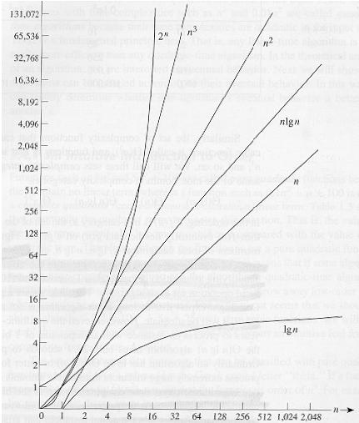
Common orders of magnitude

Slide 27
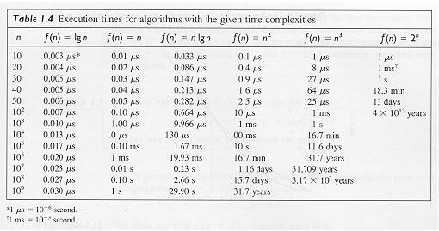

Slide 28
Estimating running time
Algorithm 1 Algorithm 2
Cost Cost
arr[0] = 0; c1 for(i=0; i<N; i++) c2
arr[1] = 0; c1 arr[i] = 0; c1
arr[2] = 0; c1
...
arr[N-1] = 0; c1
----------- -------------
c1+c1+...+c1 = c1 x N (N+1) x c2 + N x c1 =
(c2 + c1) x N + c2
O(N)

Slide 29
Estimate running time (cont.)
Cost
sum = 0; c1
for(i=0; i<N; i++) c2
for(j=0; j<N; j++) c2
sum += arr[i][j]; c3 ------------
c1 + c2 x (N+1) + c2 x N x (N+1) + c3 x N x N
O(N²)

Slide 30
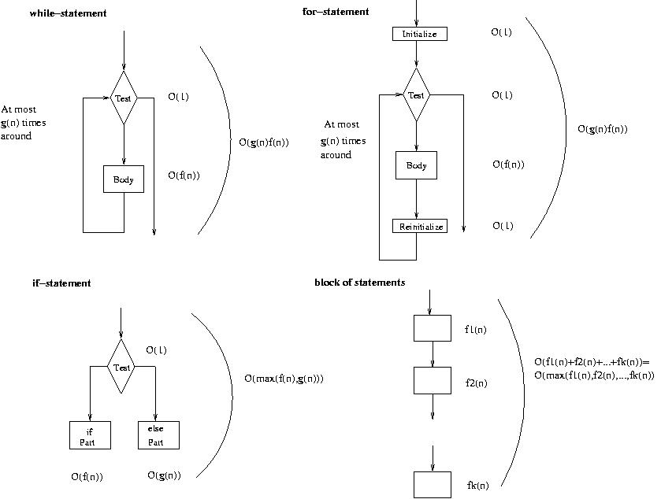
Running time of various statements
while-loop
for-loop

Slide 31
Examples
i = 0;
while (i<N) {
X=X+Y; // O(1)
result = mystery(X); // O(N), just an example...
i++; // O(1)
}
The body of the while loop: O(N)
Loop is executed: N times
N x O(N) = O(N²)

Slide 32
Examples (cont.’d)
if (i<j)
for ( i=0; i<N; i++ )
X = X+i;
else
X=0;
Max ( O(N), O(1) ) = O (N)
O(N)
O(1)

Slide 33
Examples (cont.’d)
for (i=1;i<=n;i=i*2)
for (j=1;j<=n;j++)
k=i+j;
O(N log N)
O(N * log N)

Slide 34

General Rules
For loops
  at most the running time of the statements inside the for-loop (including tests) times the number of iterations.
Nested for loops
  the running time of the statement multiplied by the product of the sizes of all the for-loops.
  O(N²)

Slide 35
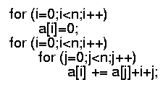
General rules (cont’d)
Consecutive statements
  These just add
  O(N) + O(N²) = O(N²)
If/Else
  never more than the running time of the test plus the larger of the running times of S1 and S2.

Slide 36
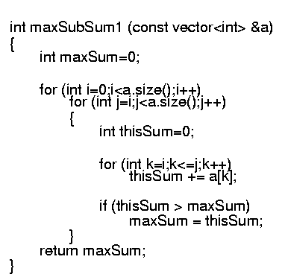
Algorithm 1: Simple
Exhaustively tries all possibilities

